Slide 1


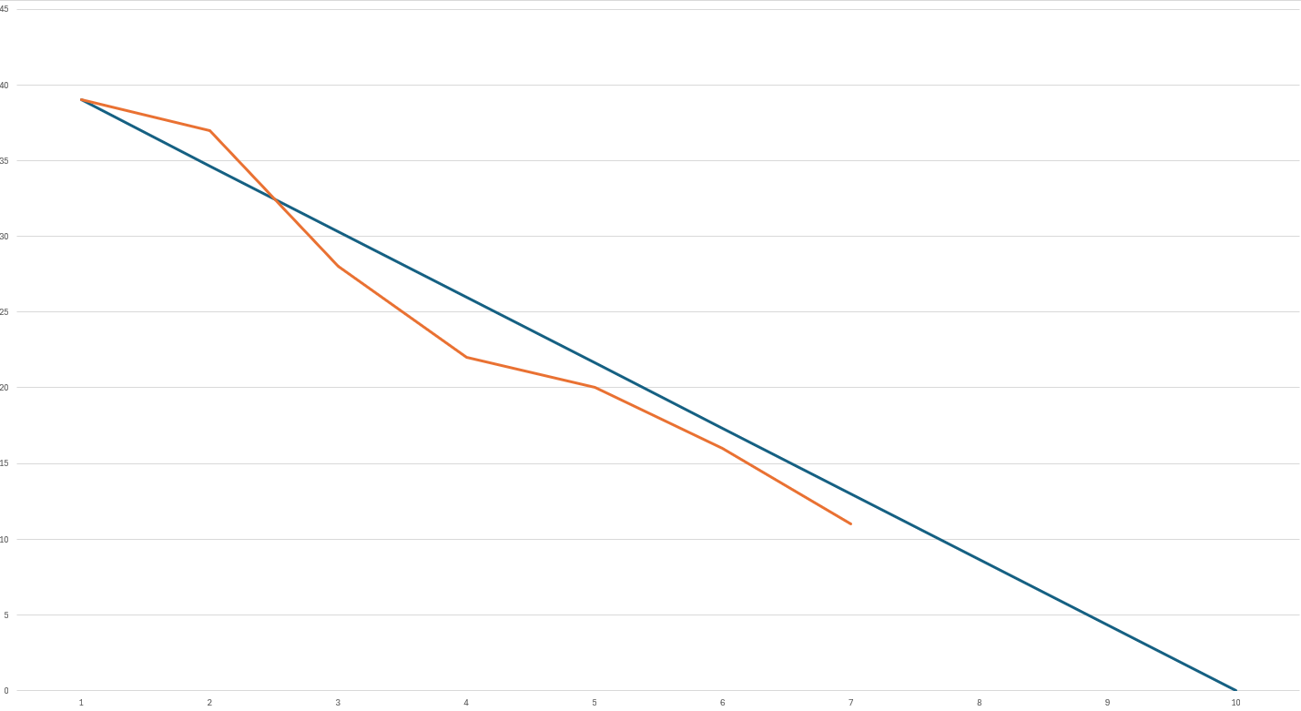
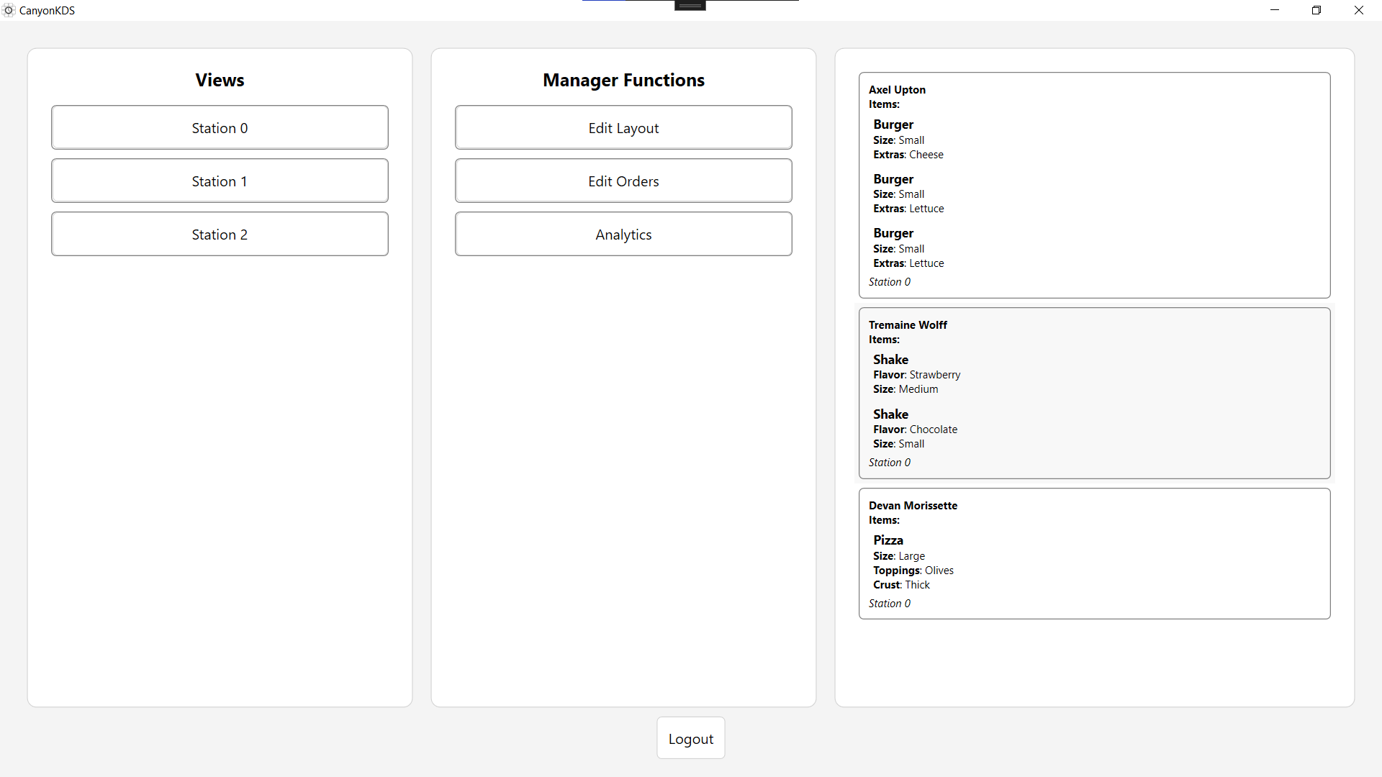
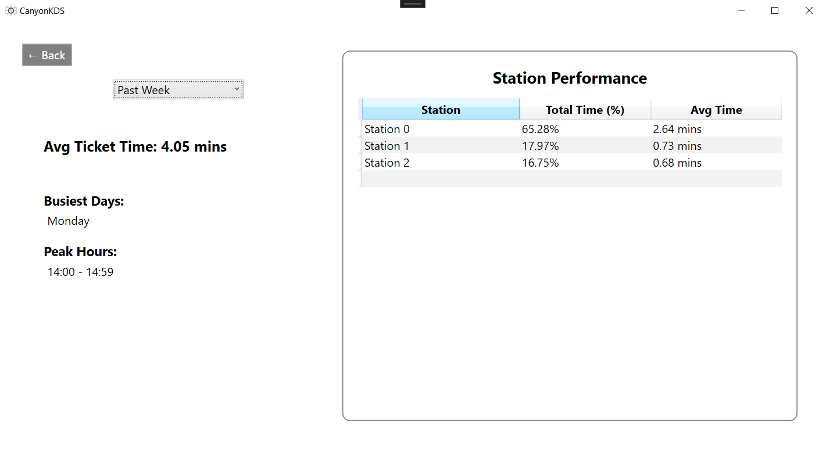
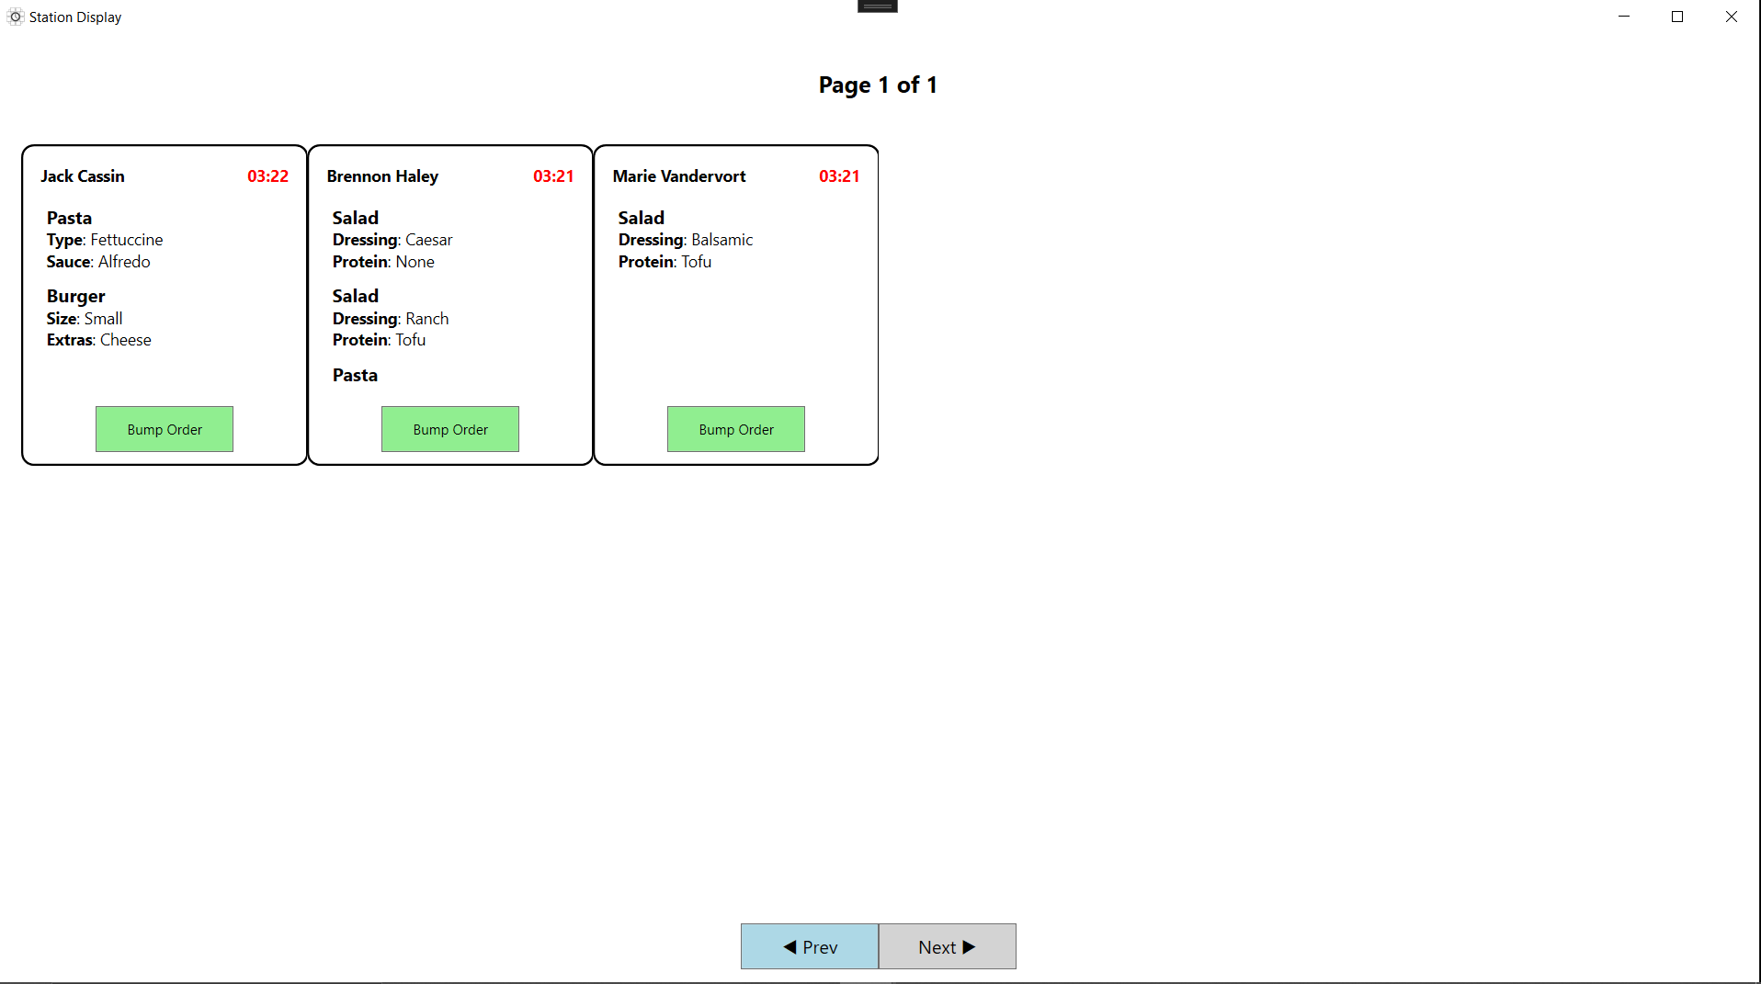
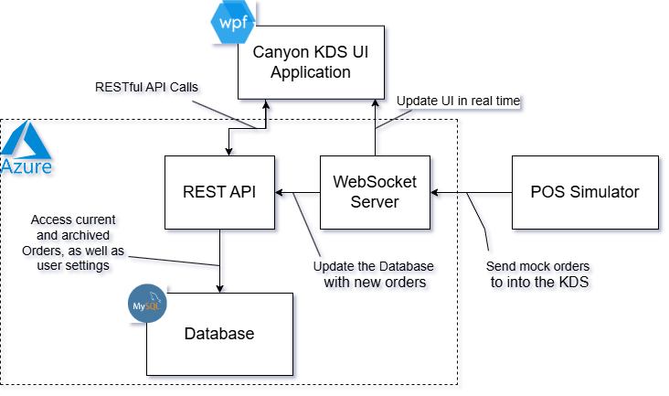








Canyon KDS
Colton Cuellar : Software Design & Development
Project Burndown
Overview
Canyon KDS is a user-friendly, modular Kitchen Display System that centralizes workflows, generates performance metrics, and offers a customizable solution for optimized operations.
Analytics
Dashboard
Station
Features
Architecture Chart
Customizable Stations
Edit Orders
Real-Time Performance Analytics
Cloud-Hosted Backend Services
Technology Stack

